Slide 1
Microsserviço com Java/Jakarta EE
Jonathan Ohara de Araujo

Slide 2
Apresentação

Slide 3
Motivação

Slide 4
Java/Jakarta EE
https://jakarta.ee/

Slide 5
Microsserviço
https://microservices.io/

Slide 6
Eclipse Microprofile
https://microprofile.io/

Slide 7
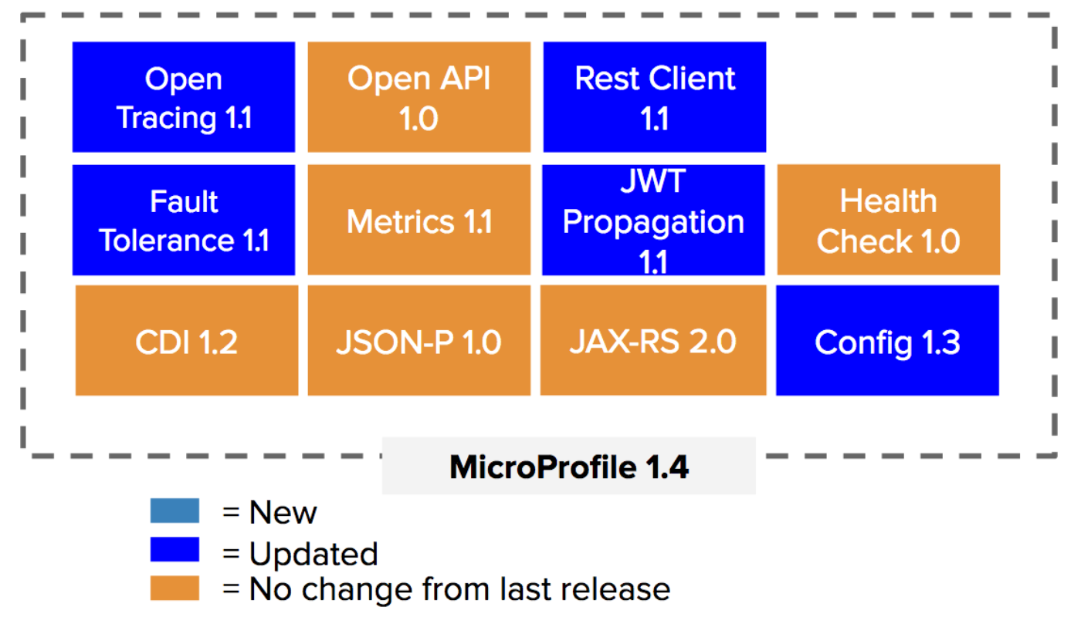

Slide 8
Payara Micro
https://www.payara.fish/software/payara-server/payara-micro/

Slide 9
Cargo Tracker
https://cargo-tracker.gitbook.io/documentation/getting-started

Slide 10
Hands On

Slide 11
Perguntas
jonathan.ohara.araujo@gmail.com
https://github.com/JonathanOhara/baixadaNerd2018
https://www.linkedin.com/in/jonathan-ohara-de-araujo/

